Slide 1

UITE – CONNECT 2023-24
The Power of Educators Working Together and Soaring New Heights
Agenda:
--Welcome & Introductions
--Program Structure & Expectations
--Activities and Discussion
--Self-Reflection Journal
--Sign in the attendance sheet.
--Pick one reflection journal, 1-2 stamps of your choice and a pen.
--Get food and socialize!

Slide 2

Dr. Frankie Lanaan (Dean, College of Education)
Prof. Mary Burbank (Associate Dean, College of Education & Director, UITE)
UITE CONNECT Team
--Kelly Haakenson (Teacher, Salt Lake Center for Science Education)
--Carol Shelton (Teacher, Eastwood Elementary)
--Udita Gupta (Associate Professor & Secondary Cohort Leader, UITE)

Slide 3



UITE CONNECT: Objectives
--SUPPORT you in your teaching journey
--Provide you with opportunities to COLLABORATE
--Help you build meaningful RELATIONSHIPS
--Provide RESOURCES to help you grow as a teacher

Slide 4
UITE – CONNECT: Operations
2023: Nov. 16, Dec. 14
2024: Jan. 18, Feb. 22, Mar. 21, Apr. 25, May 9
All via zoom except May 9
Meetings
monthly
Meeting Topics
UITE-Connectors’ decision
Topics that need attention
(UITE-Connect Team)
You will have the opportunity to coin topics via self-reflection journals + share information/resources on the topics of your expertise.
Notes:
Our team wi

Slide 5
UITE – CONNECT: Structure
Attend monthly meetings
Compensation
($500)
Participate & Collaborate
Complete self-reflection journals related to each meeting
OR
Compensation ($500)
+
1 UofU Credit
Attend monthly meetings
Participate & Collaborate
Complete self-reflection journals related to each meeting
Complete application reflection journals
Payment is based on full participation in meetings.
Notes:
Our team wi

Slide 6
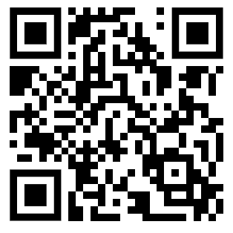
UITE – CONNECT Web Page
https://uite.utah.edu/students/uite-connect/

